Slide 1

The Cost of School Security
Karen J. DeAngelis, Ph.D.
Associate Dean for Academic Programs
Associate Professor and Chair, Educational Leadership
kdeangelis@warner.rochester.edu
Brian O. Brent, Ph.D.
Senior Associate Dean for Graduate Studies
Earl B. Taylor Professor, Educational Leadership
bbrent@warner.rochester.edu

Slide 2
Purpose of the Study
To shed light on the costs borne by districts related to security practices and how these costs vary across districts
To understand what security practices are used and how they differ across settings

Slide 3
This study focused on measures that seek to address school violence, as defined by Thomas (2006) – that is, actions that disrupt the school… cause harm… or destroy property.
These measures generally are categorized as either:
  Prevention activities – programs/strategies that seek to decrease the probability that students will engage in violent acts
  Security measures – also referred to by Astor, Guerra, & VanAcker (2010) as “target hardening” – practices that make a school a less desirable target.
We focused on the second category – security measures – on account of our inability to disaggregate prevention activities in our datasets.
Definition

Slide 4
Data & Methods
Texas Education Agency’s Public Education Information Management System (PEIMS)
NCES’
School Survey on Crime
and Safety (SSOCS)
District-level data of actual expenditures from 2008-09
Population data – 1030 Texas public school districts
Function code 52 – Security and Monitoring Services
Descriptive statistics, overall and by locale type
Multivariate regression
School-level data from 2007-08
Nationally-representative stratified sample of U.S. public schools
Principals’ responses regarding their schools’ use of security measures
Descriptive statistics, overall and by locale type

Slide 5
Findings: Texas data

Slide 6
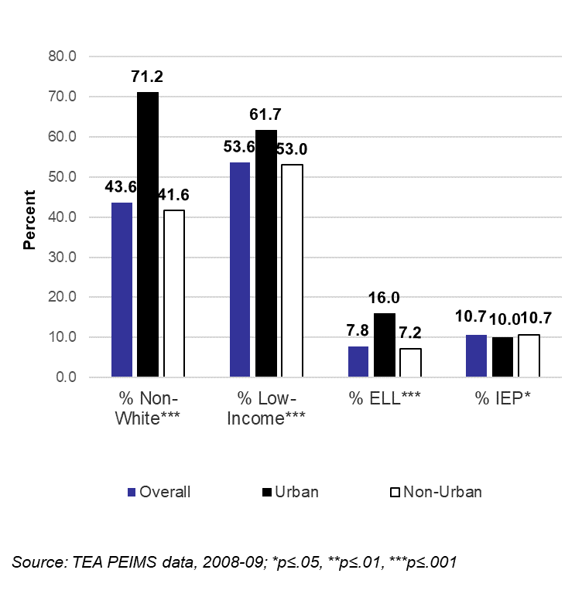
Descriptive Statistics for Texas Districts
Notes:
6

Slide 7
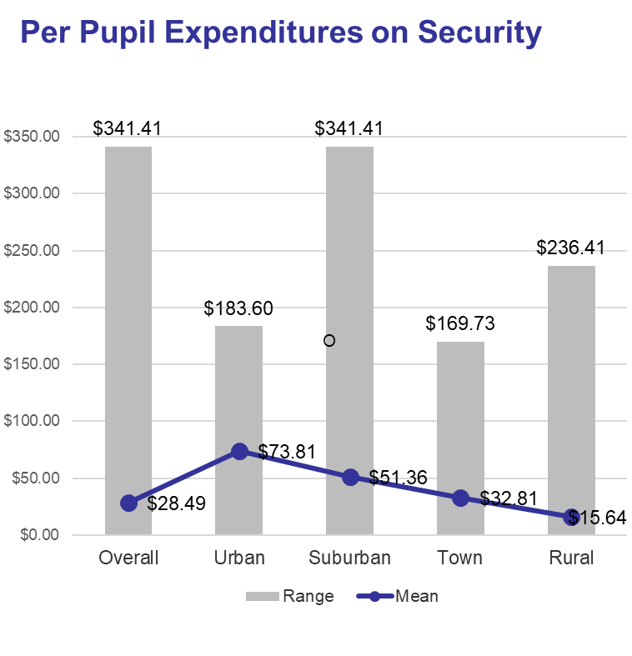
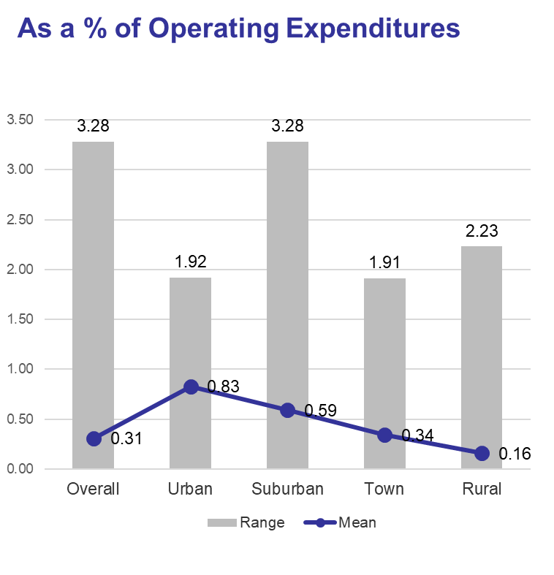
Urban Districts Spend Significantly More on Security
Source: TEA PEIMS data, 2008-09; All differences across locale types are statistically significant at p≤.05.

Slide 8
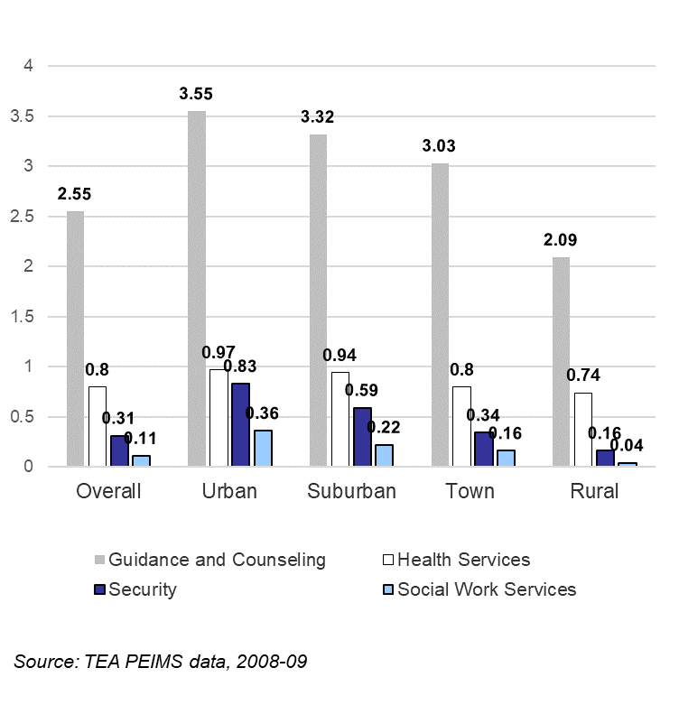
Security Spending in Perspective
(% of Operating Expenditures)
Notes:
8

Slide 9
Factors Associated with Security Spending
(As % of Operating Expenditures)
 | Model I | Model II | Model III
Constant | 0.482 | 0.501 | 0.197
Locale Typeª
Suburban | -0.046 | -0.048 | 0.010
Town | -0.183** | -0.182** | -0.160**
Rural | -0.338*** | -0.332*** | -0.236***
Enrollment (per 100 students) | .002*** | .002*** | 0.002***
Enrollment (per 100 students)² | -9.2E-7*** | -9.0E-7*** | -8.6E-7***
Wealth per ADA |  | -4.1E-8** | -3.3E-8**
% Low-income students |  |  | 0.002**
% Non-white students |  |  | 0.003***
Adjusted R² | .332 | .338 | .397
N | 1025 | 1025 | 1025
ª Urban is reference category. ***p ≤ .001, **p≤0.01, *p≤0.05
Notes:
9

Slide 10
Findings: SSOCS data

Slide 11
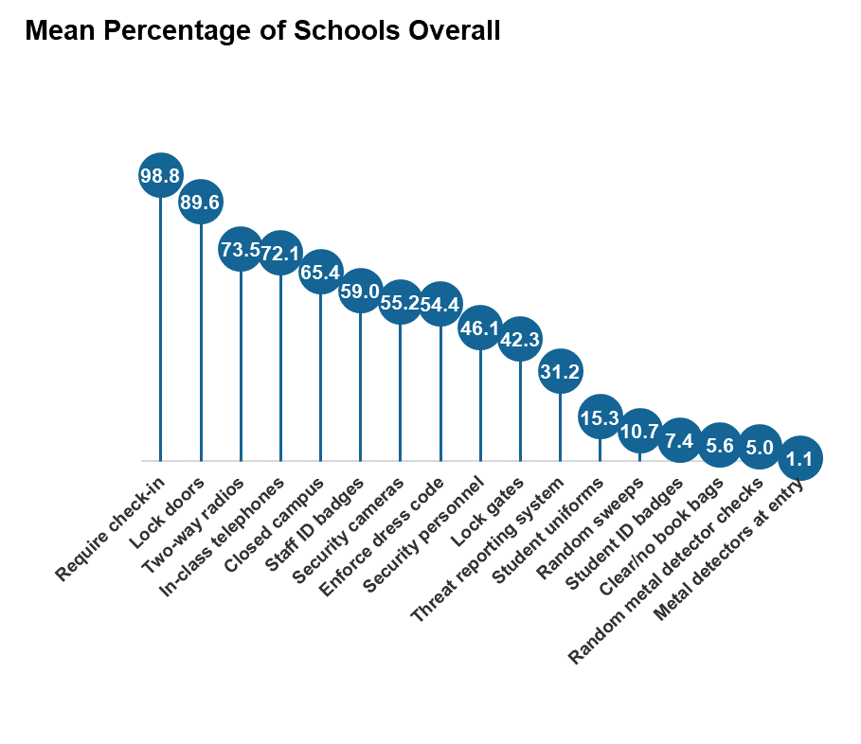
What Schools Buy
Source: NCES’ SSCOS data, 2007-08
.
Notes:
11

Slide 12
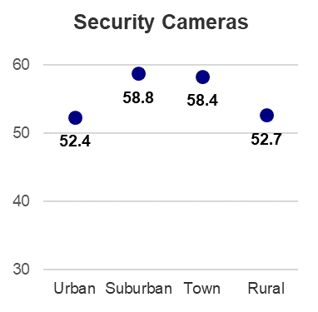
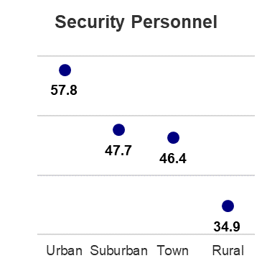
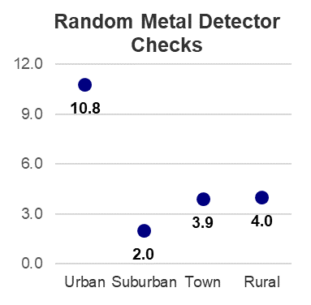
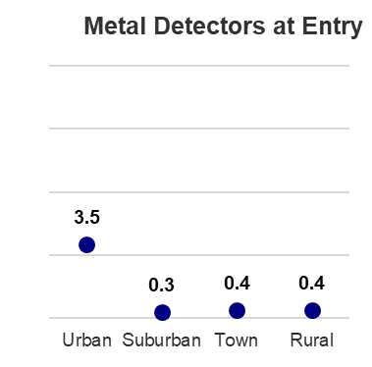
Significantly More Urban Schools Use Security Personnel and
Metal Detectors
(% of schools)
Source: NCES’ SSCOS data, 2007-08
.
Notes:
12

Slide 13
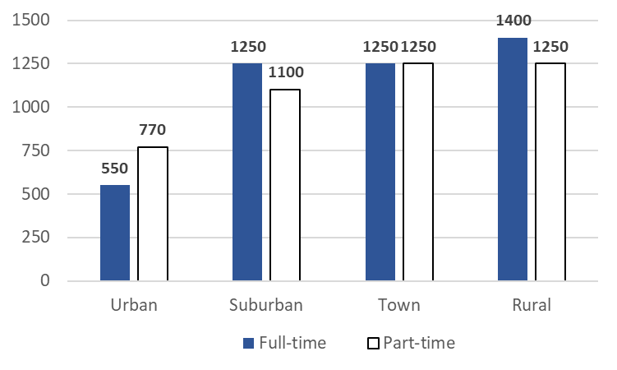
Mean Number of Students Per
Full- and Part-Time Security Person
Source: NCES’ SSCOS data, 2007-08; Urban schools significantly different from all other locale types at p≤.05.

Slide 14
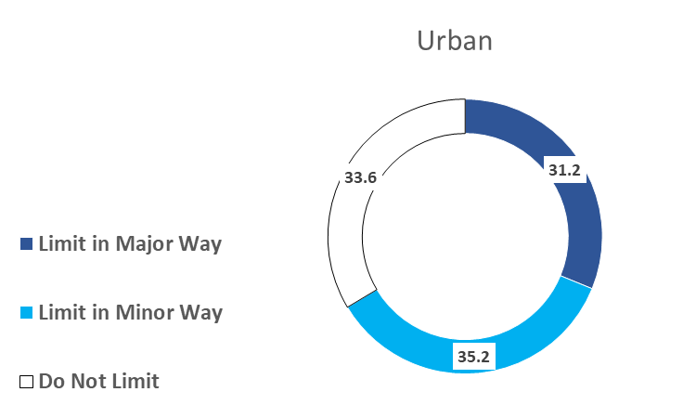
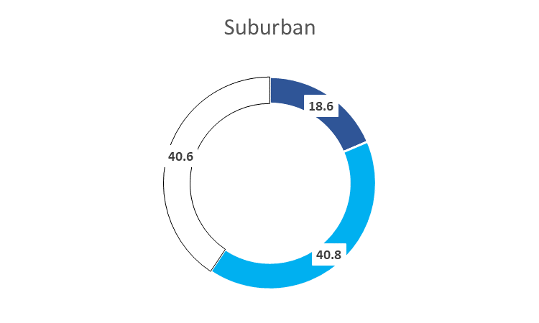
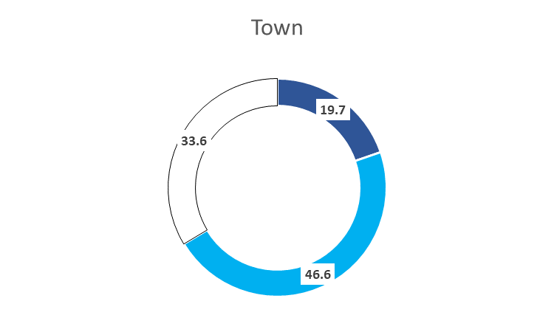
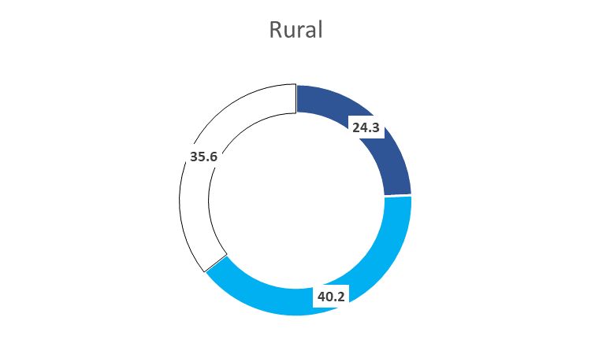
Extent to Which Inadequate Funds Limit Efforts to Secure U.S. Schools
(% of schools)

Slide 15
Conclusions and Limitations
Spending on school security varies widely across districts within and across locale types.
On average, urban districts allocate a disproportionately higher share of their educational resources to securing their schools.
Our estimates provide a lower bound on districts’ expenditures to secure schools on account of our inability to:
  (i) assess their spending on prevention activities and
  (ii) determine the extent to which spending in other function codes, such as leadership or general administration, includes costs associated with keeping students safe.
At the time of this study, Texas was the only state that required its districts to report security spending in a separate function code. To more fully understand the cost of school security, we need other states to do the same.

Slide 16
References
Astor, R.A., Guerra, N., & VanAcker, R. (2010). How can we improve school safety research? Educational Researcher, 39(1), 69-78.
DeAngelis, K.J., & Brent, B.O. (2012). Books or guards? Charter school security costs. Journal of School Choice, 6, 365-410.
DeAngelis, K.J., Brent, B. O., & Ianni, D. (2011). The hidden cost of school security. Journal of Education Finance, 36(3), 312-337.
Thomas, R. M. (2006). Violence and America’s schools: Understanding, prevention and responses. Westport, CT: Praeger Publishers.

